Slide 1
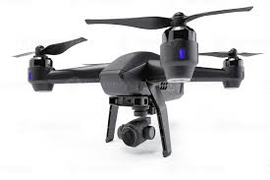
Operations on Swarm of Drones Formation and Shape Control
Students: Oz Arye and Arnold Cheskis
Supervisor: Ofer Danino
Semester: Spring, 2023
Finish date: February 2024

Slide 2
Outline
Introduction and Importance
Project Goal
Our System and app
Methods
Video
Challenges
References

Slide 3

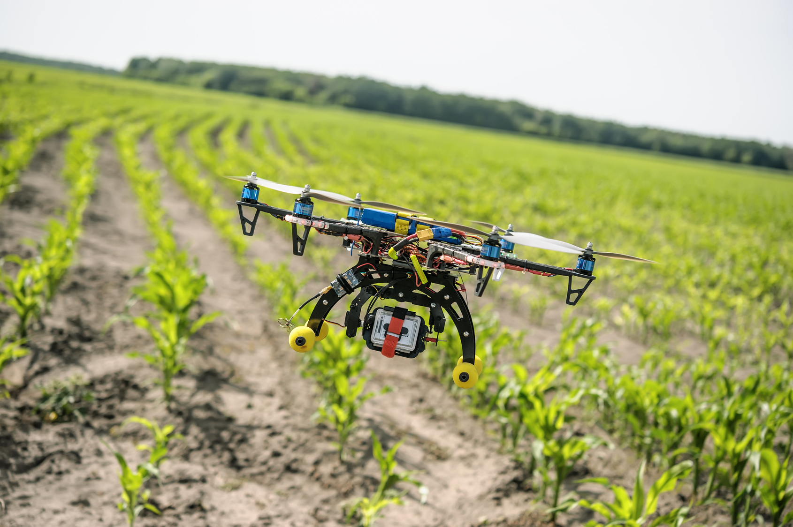
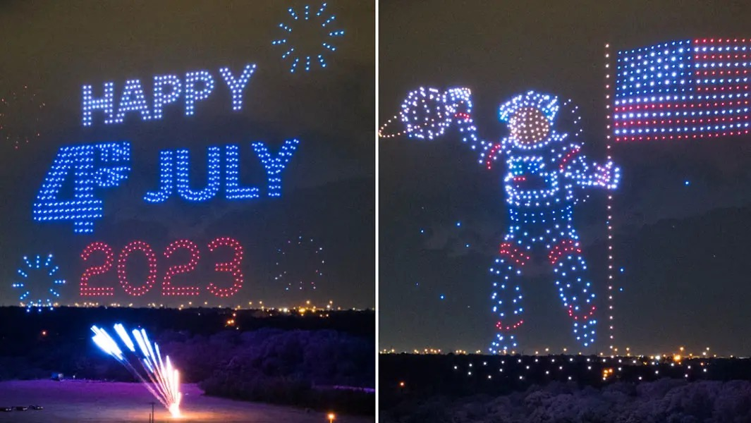
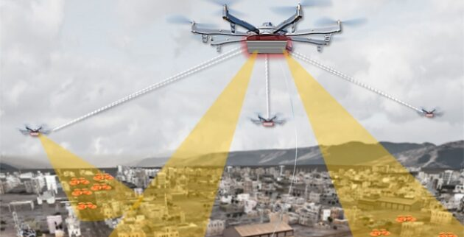
Why drone swarms are important?
Agriculture
Entertainment
An MIT Development
Boat festival, Shenzen, China
Security
World Guinness record,
4th of July

Slide 4
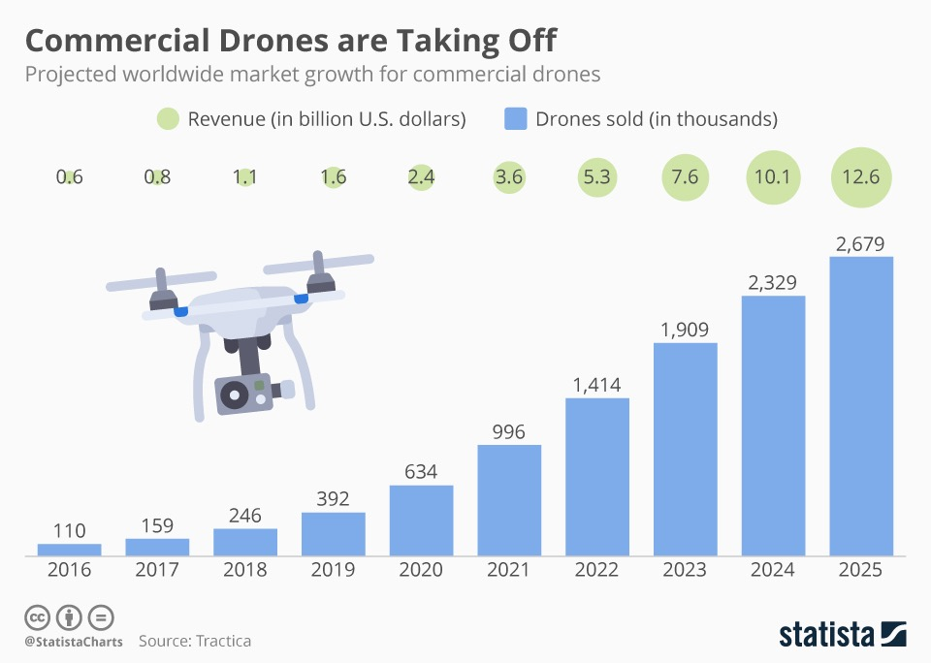
Drones’ usage growth

Slide 5
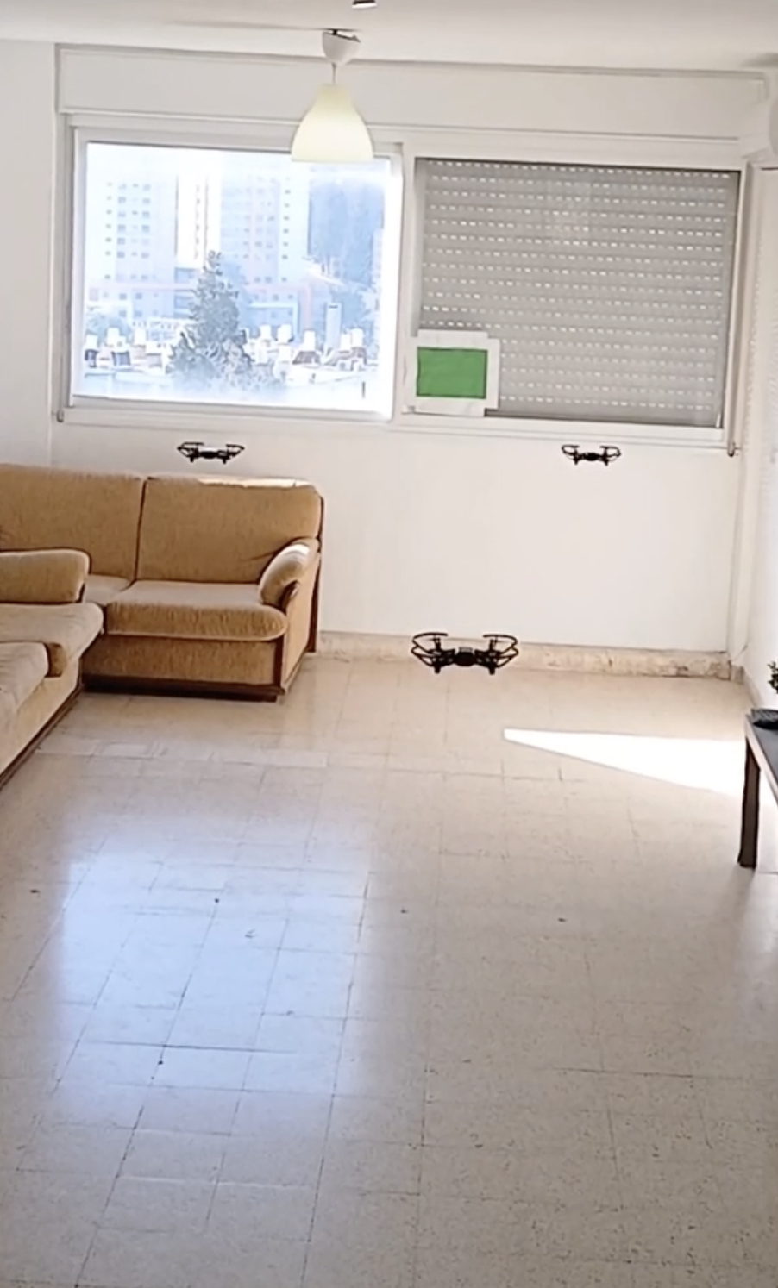
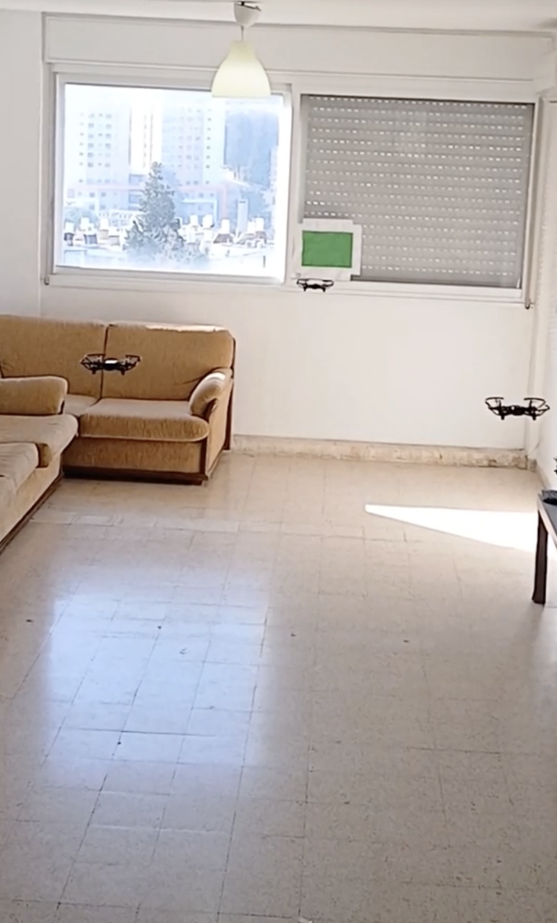
The Goal
Create a powerful tool to control a complicated movement of drone swarms
No coding needed Easy to use
Accessible, i.e. utilizes cloud services

Slide 6
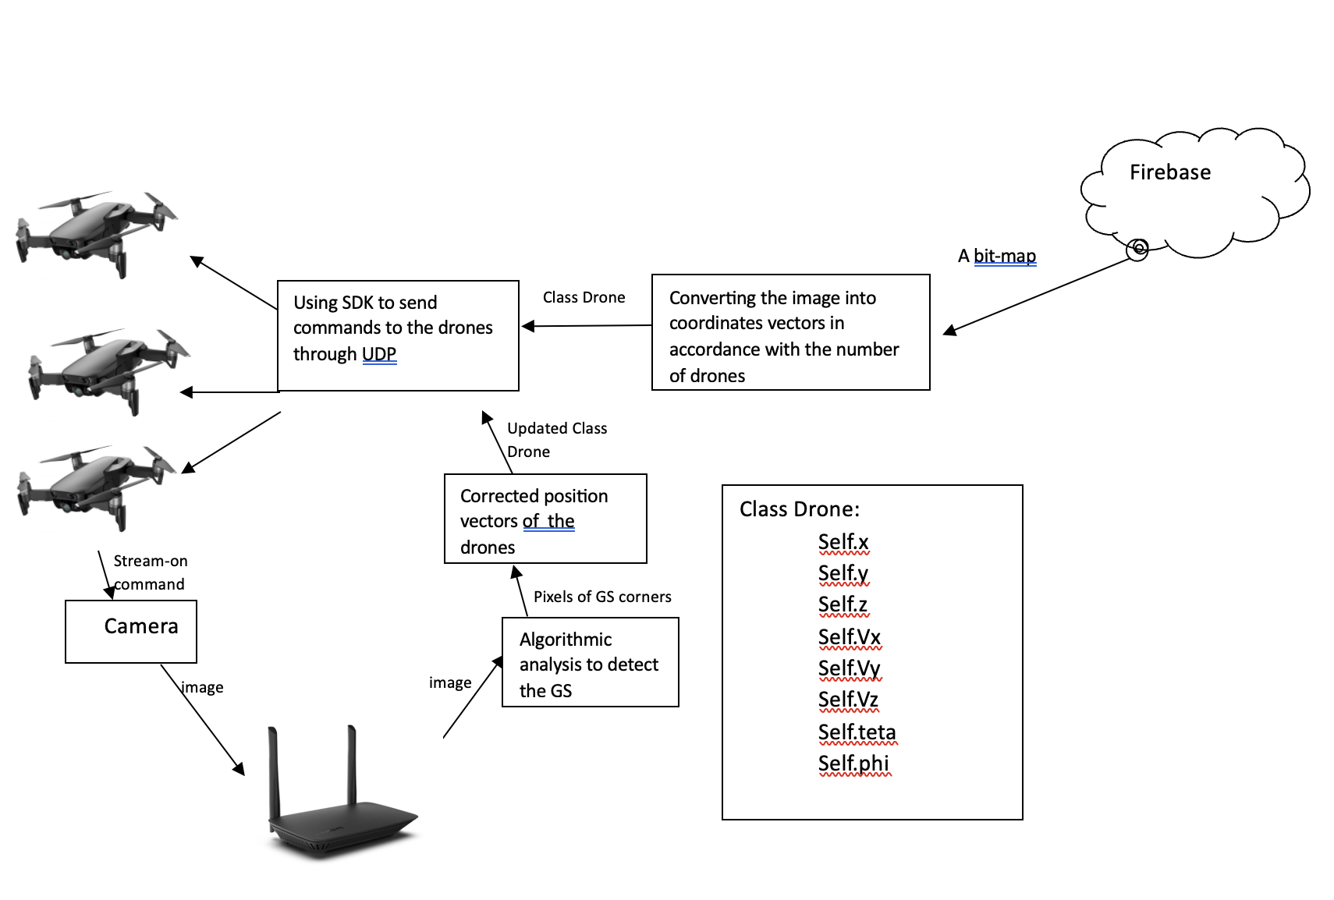
Our system

Slide 7
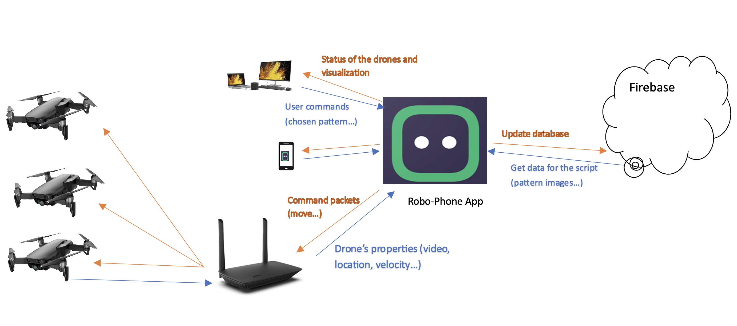
Abstraction of the system using Robo-Phone as an OS

Slide 8

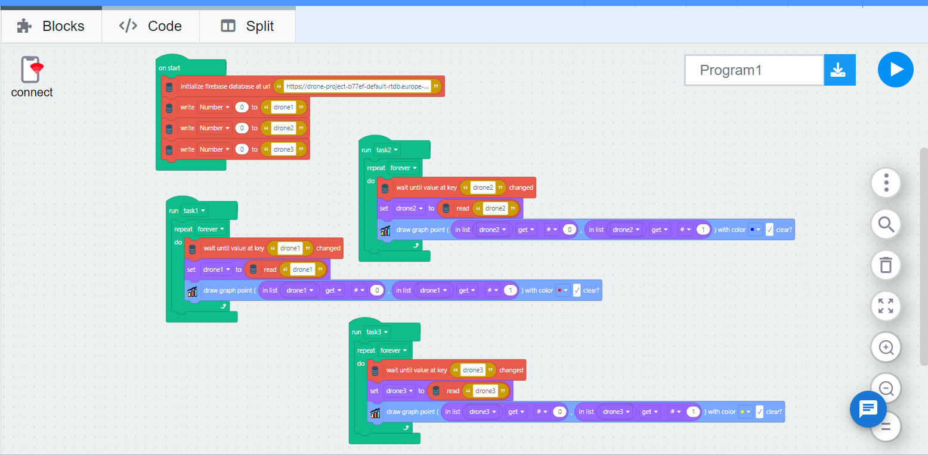
Application

Slide 9
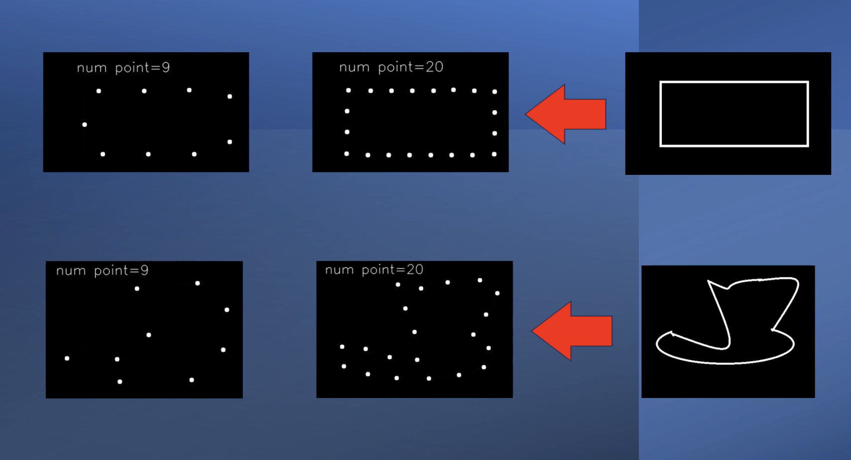
Converting the image to a pattern
From the discrete pattern, we can derive the drones’ movement coordinates

Slide 10
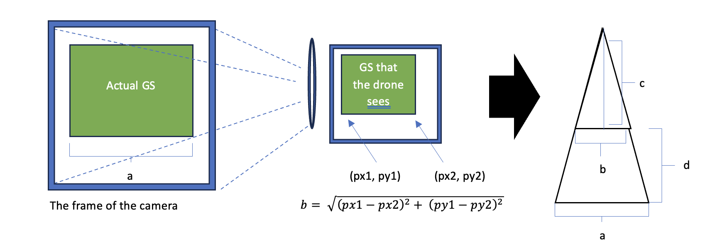
Position detection using the Green Square

Slide 11
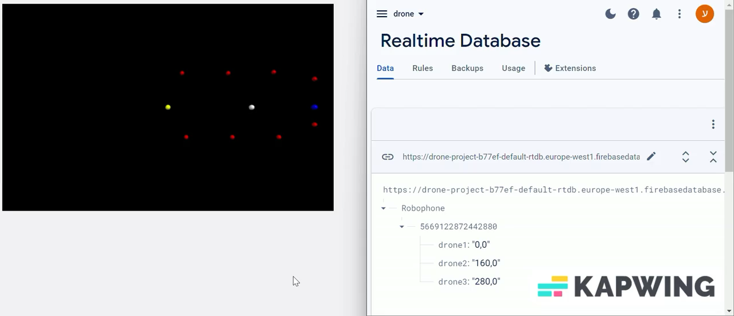
Firebase and Path simulation

Slide 12
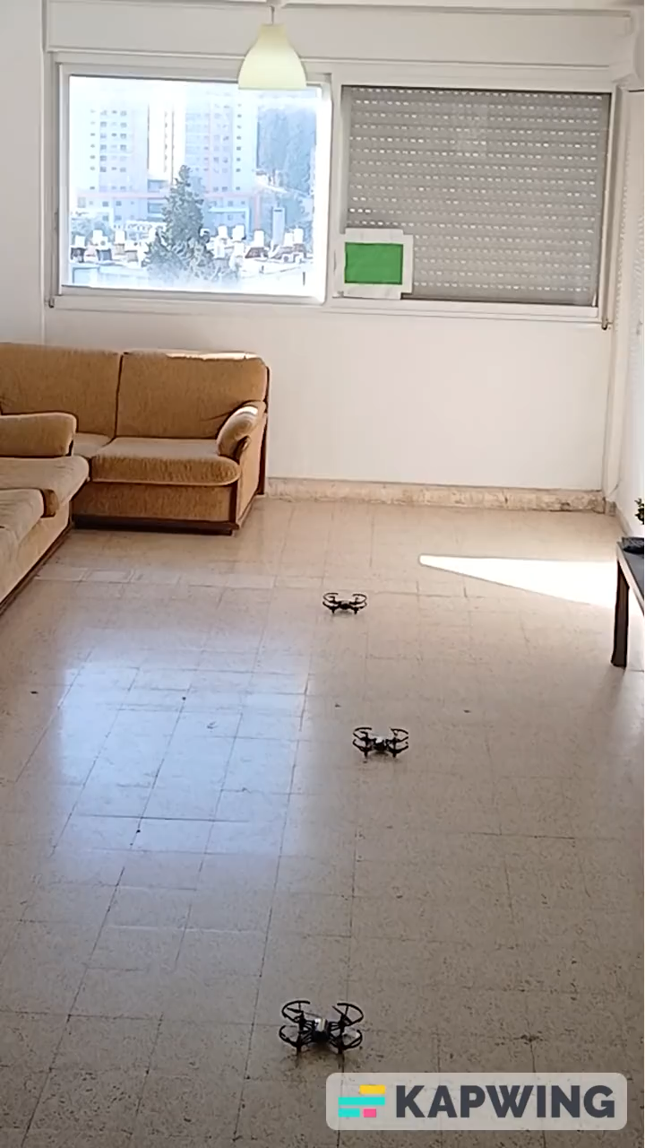
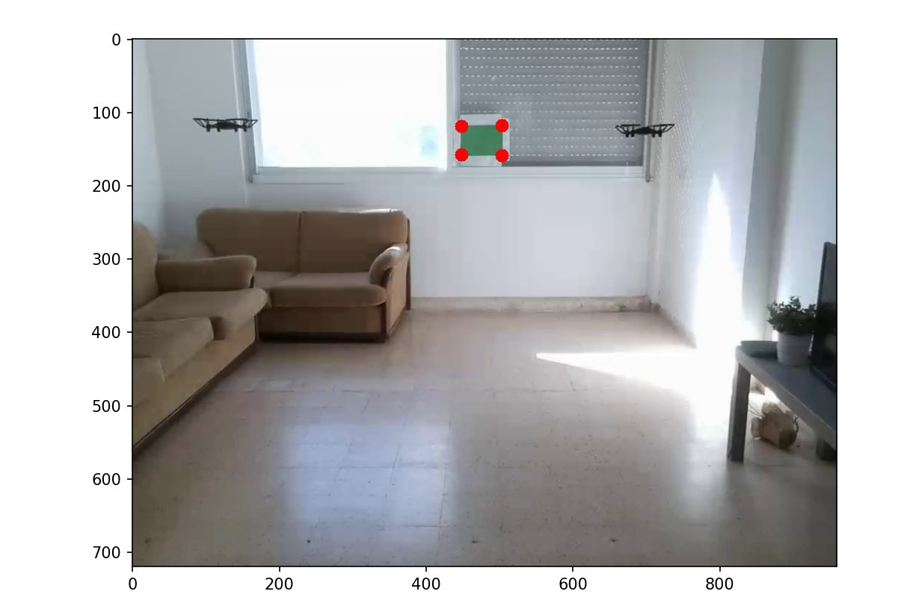
POV from an external source vs. Drone’s camera
Project Overview
https://youtu.be/jhX8cq-zeDI

Slide 13
Challenges
Drones’ instability, especially with cheaper ones used outdoors where external forces have great significance.
The bandwidth of the WIFI channels limits the amount of feedback the computer can get, in the form of images, from the drones. This in turn affects the speed of the pattern correction.
Delayed communication with the cloud prevents us from running the algorithms on the server and saving space on the PC.

Slide 14
References
[1] Commercial Drones are Taking Off, Statista, 2019; link
[2] The 1,500 drone dragon that danced in the Shenzhen sky, AV Magazine, 2022; link
[3] Patriotic drone show lights up the sky with record-breaking aerial message, Guinness World Record, 2023; link
[4] Echodyne and Univ. of Washington assist DARPA with aerial drone surveillance test, GeekWIRE, 2019; link
[5] Agricultural Drones, MIT Technology Review , 2014; link
[6] Manual for the Ryzo drone (SDK) in this link.
[7] Drone swarm libraries in this link, and this link.
[8] H264 decoder (for the streaming in UDP channel) in Dewalter’s git repository; link.
[9] To start with Firebase we used the tutorial in this link.

